Slide 1
Data Visulization Chicago Crime
Yuehchao Wu

Slide 2
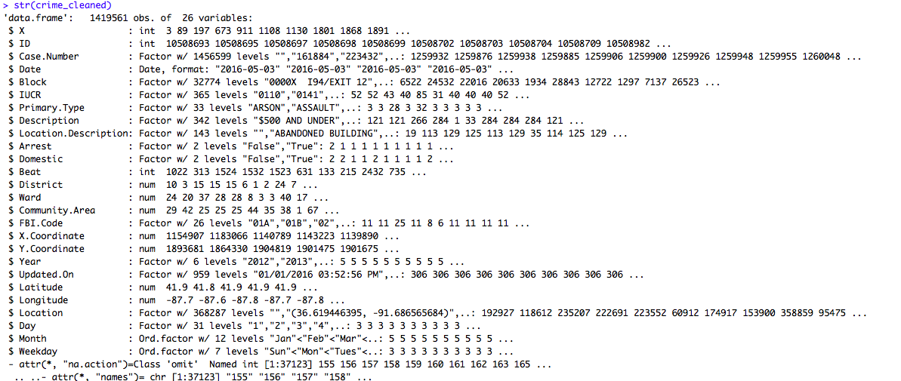
Data Description

Slide 3
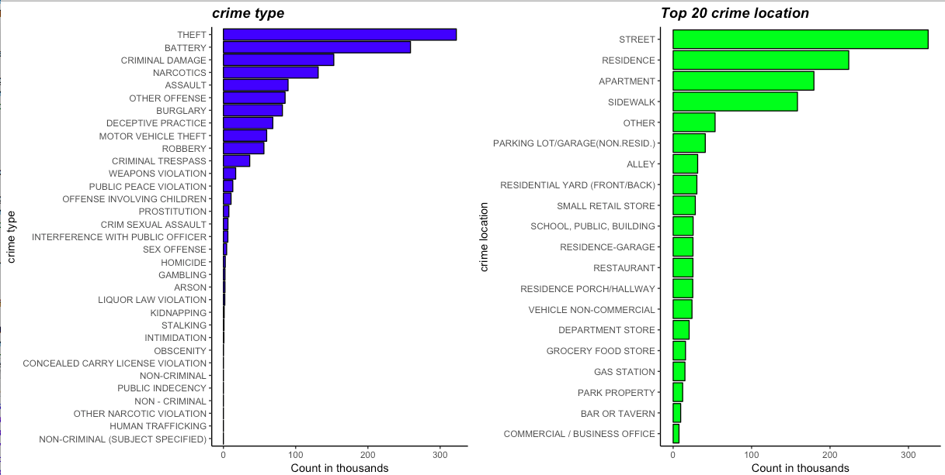
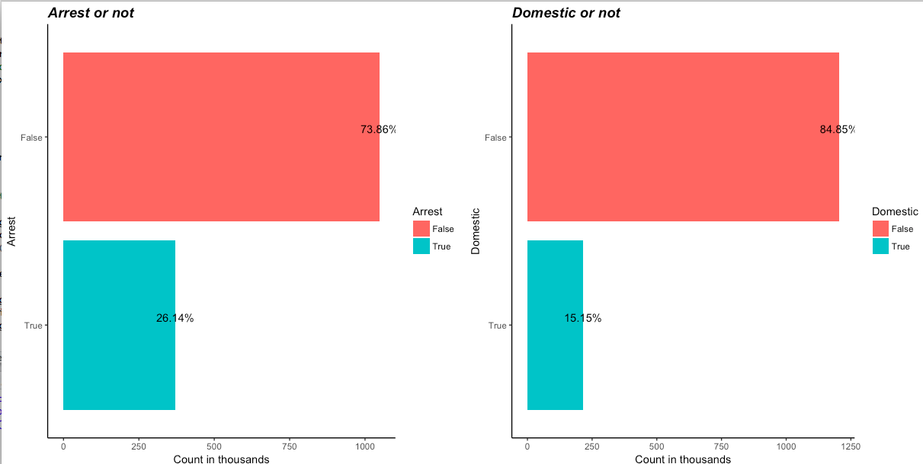
Initial Exploratory Visualization

Slide 4
Technique1: Set of exploratory Graphs
Dot chart
Bar chart
Tree map

Slide 5
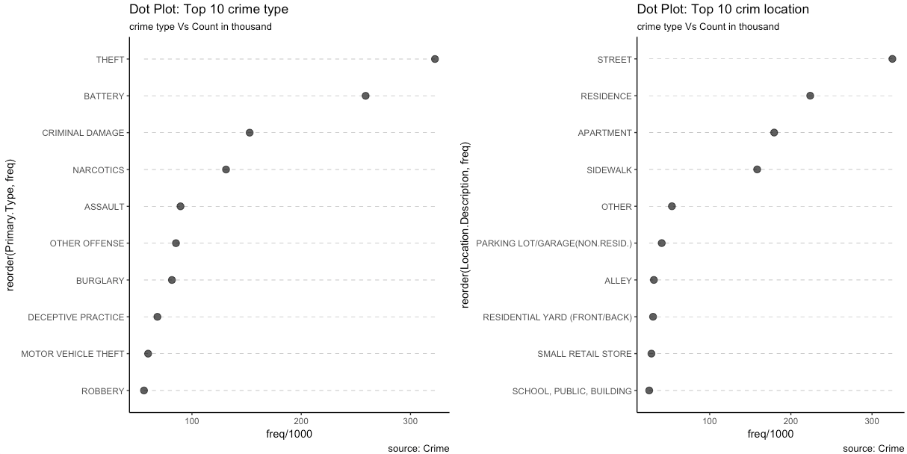
Dot chart: crime location and Type

Slide 6
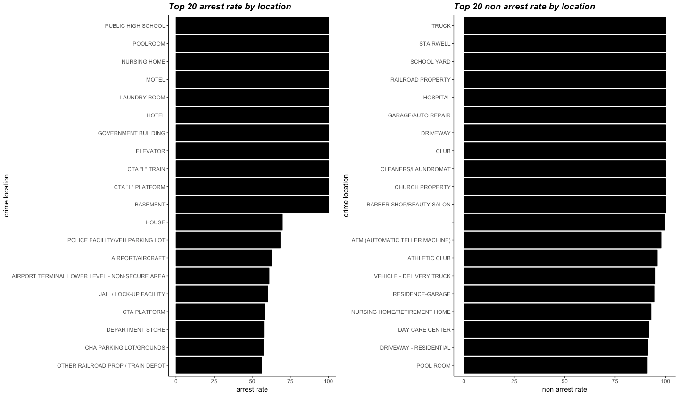
Location VS Arrest Rate

Slide 7
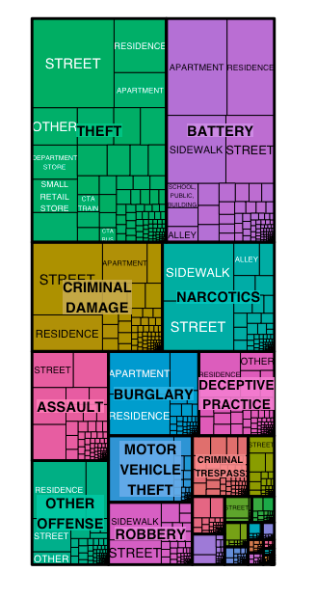
Tree map: location and crime type

Slide 8
Technique 2: Time Series
Line plot
heat map

Slide 9
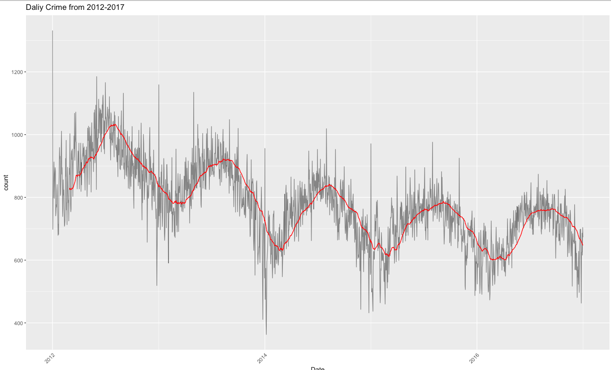
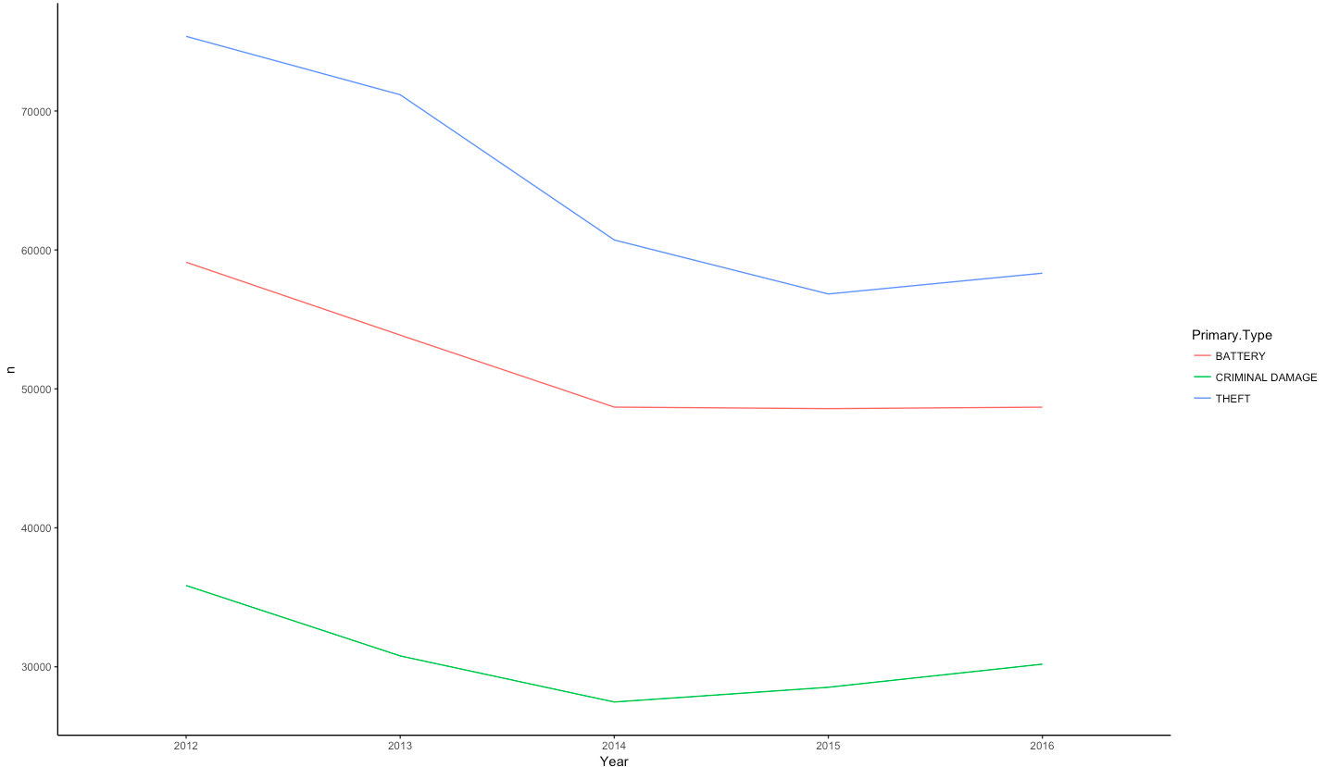
Line plots

Slide 10
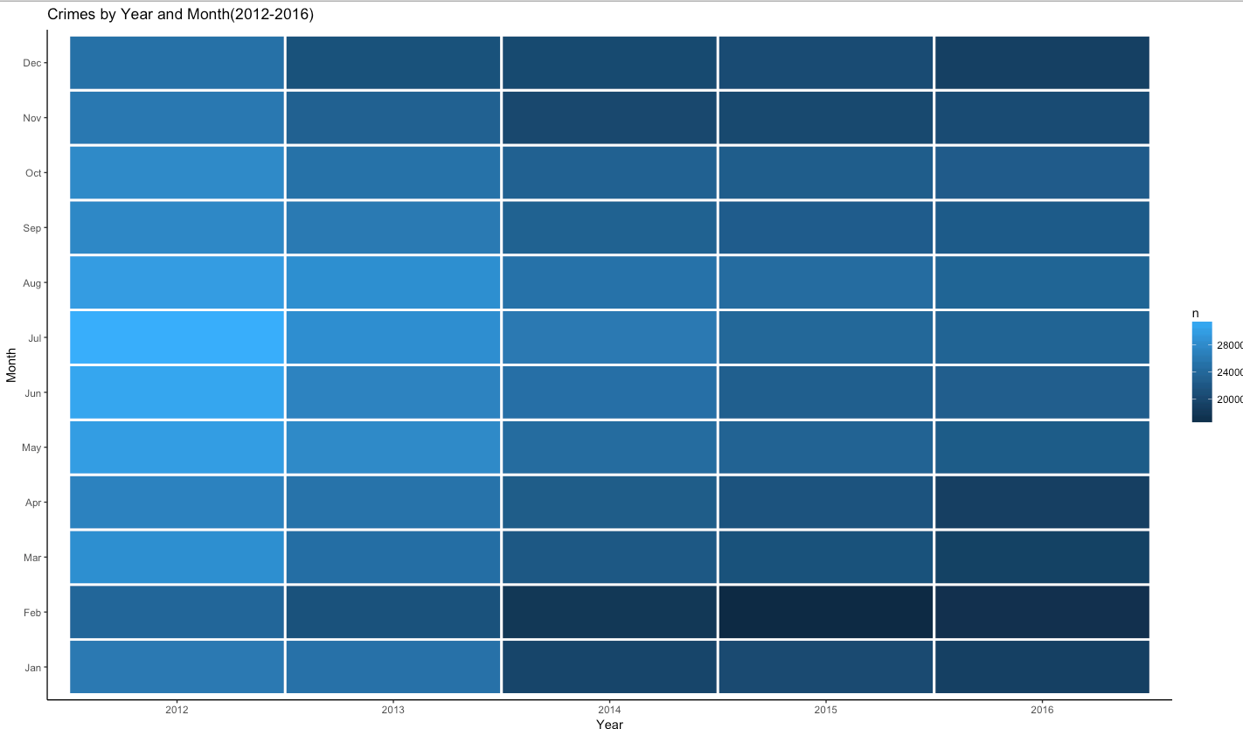
Heatmap

Slide 11
Technique 3: Geographical Graph
False Color Heat Map
Overall
Top Crime type and selected ones

Slide 12
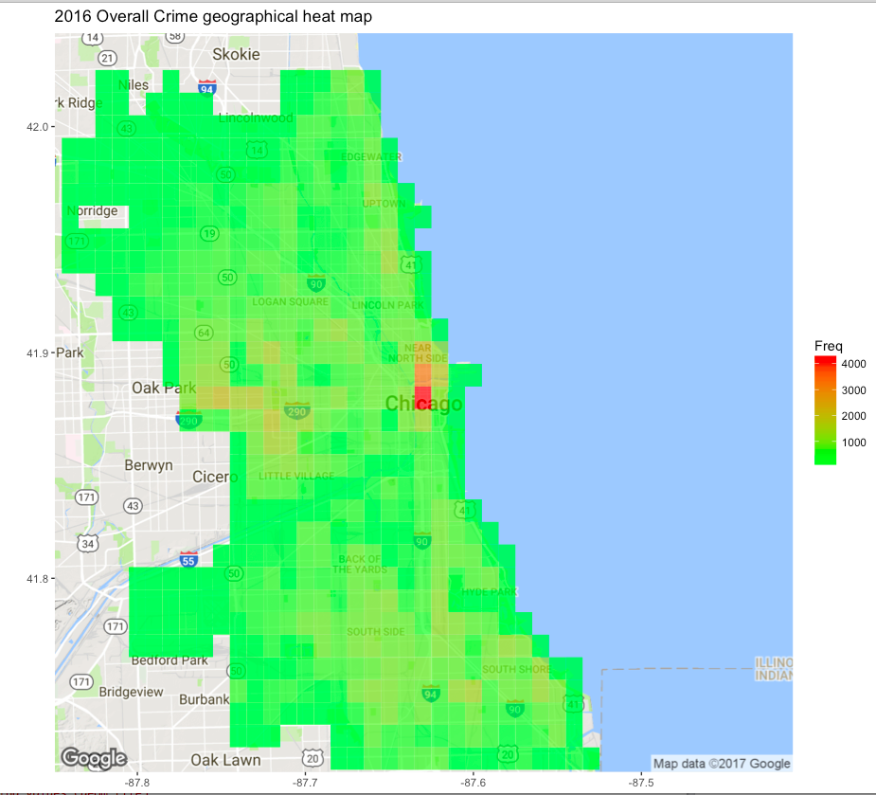
Overall crime on 2016

Slide 13
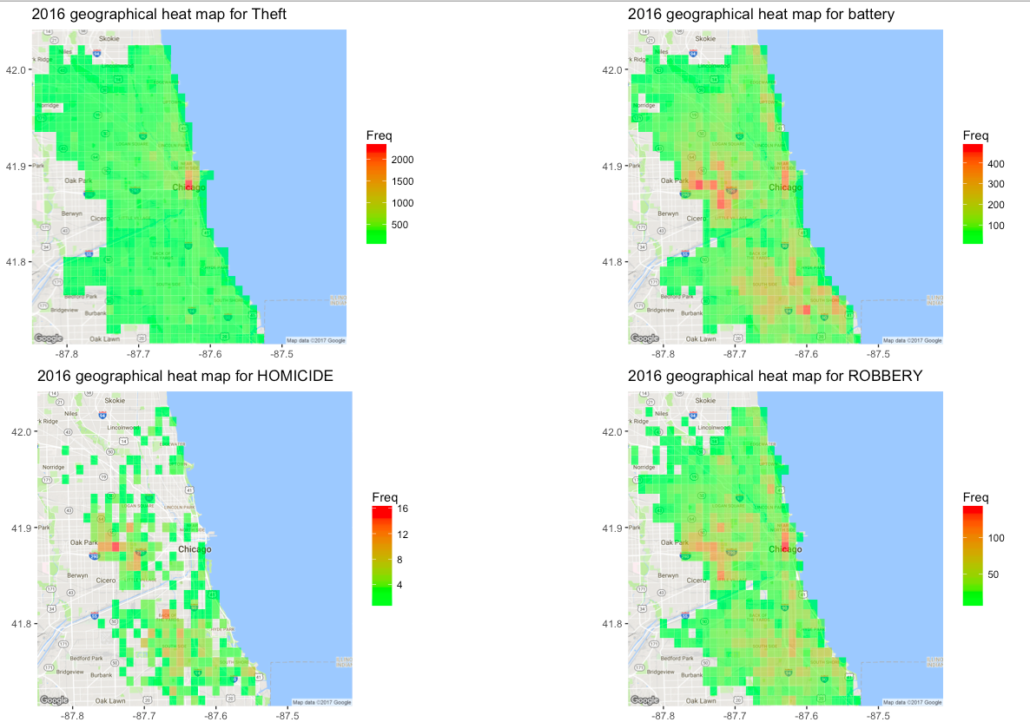
Crime on 2016 by type

Slide 14
Conclusion and Reflection
Crime at Chicago has declined
Recurring high crime on Jun-august every year
Crime Hot spot :Downtown, south side and between oak park and downtown
Future: Interactive Map

